Slide 1
Retail-Giant Sales Forecasting Case Study SUBMISSION
Group
Samik Bhattacharya
Varsha Shastri G
Guruchetan Prabhakar
Nitin Dhamija

Slide 2
Abstract
“Global Mart” is an online store super giant having worldwide operations.
It takes orders and delivers across the globe.
Deals with all the major product categories - consumer, corporate & home office.
Problem Statement
Forecast the sales and demand for the next 6 months, so that revenue and inventory for “Global Mart” can be managed accordingly.
Approach
Perform time series modelling that identifies the Global, Local trend and noise and maximizing the log likelihood.

Slide 3
Problem solving methodology
Aggregate dataset on “Market” and “Segment” to identify 2 most consistently profitable Market Segment
Aggregate the transaction level data for the identified Market Segments at month level for “Sales”, “Quantity” and the “Profit”
Segregate the test and train dataset
Plot and smoothen the time series
Use Advance regression to get the best fit
Check for the Noise. Calculate ACF and PACF (should be less than the critical values)
Optimal value of p,d,q for ARIMA modelling
Calculate the MAPE value for the regression
Calculate the MAPE value for the ARIMA
Start

Slide 4
Top Profitable Segments
Market | Segment | Profit_sum | Profit_cv
APAC | Consumer | 222817.560 | 63.21323
EU | Consumer | 188687.707 | 62.43052
US | Consumer | 134119.209 | 101.23900
APAC | Corporate | 129737.235 | 69.80869
EU | Corporate | 123393.980 | 76.38072
LATAM | Consumer | 120632.932 | 66.14828
US | Corporate | 91979.134 | 100.24089
APAC | Home Office | 83445.254 | 104.59784
EU | Home Office | 60748.054 | 111.65073
Market | Segment | Profit_sum | Profit_cv
The two most profitable market segments also happen to be the two most consistent market segments. This can be seen as shown in the above table with 2 highest value for Profit_sum and 2 least values for Profit_cv

Slide 5
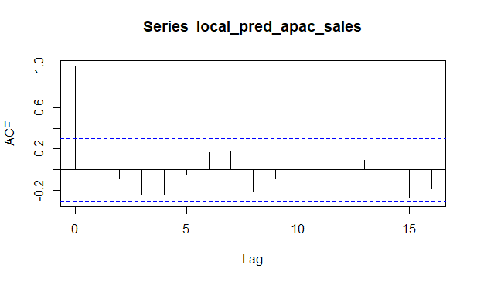
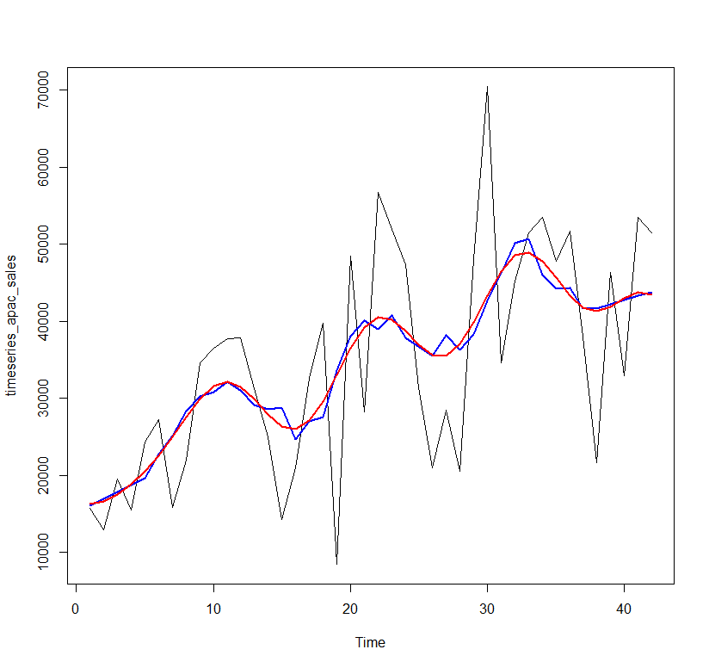
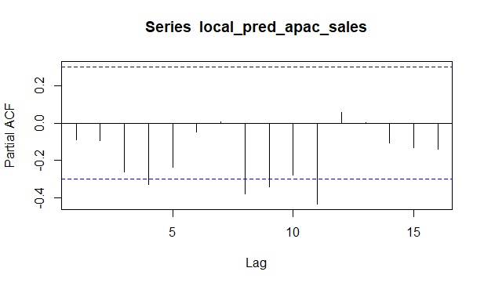
Time Series Analysis of Sales for CONSUMER Segment in APAC marketplace with Trendline Degree 3 – MAPE 37.38
-- Actual Time Series
-- Smoothen Time Series
-- Trend

Slide 6
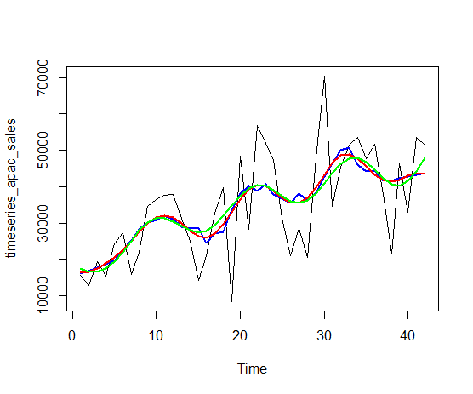
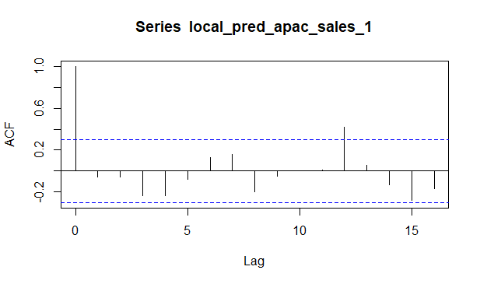
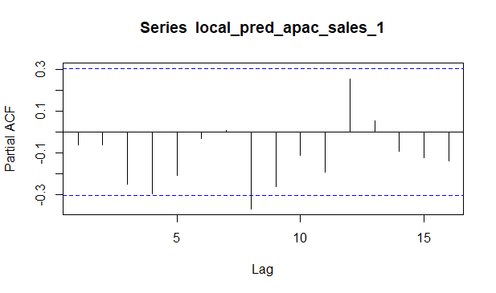
Time Series Analysis of Sales for CONSUMER Segment in APAC marketplace with Trendline Degree 2 – MAPE 27.7
-- Actual Time Series
-- Smoothen Time Series
-- Trend Polynomial Degree 3
-- Trend Polynomial Degree 2

Slide 7
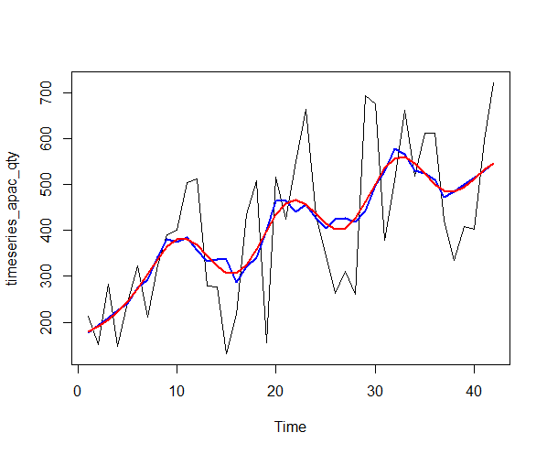
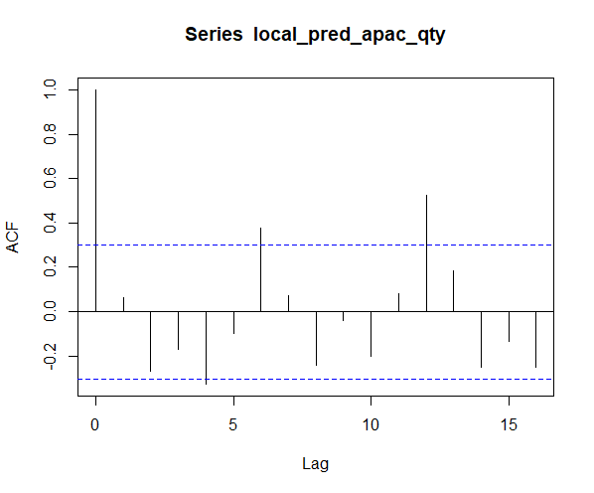
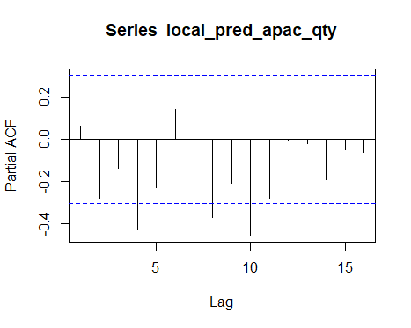
Time Series Analysis of Quantity for CONSUMER Segment in APAC marketplace with Trendline Degree 2 – 30.49
-- Actual Time Series
-- Smoothen Time Series
-- Trend

Slide 8
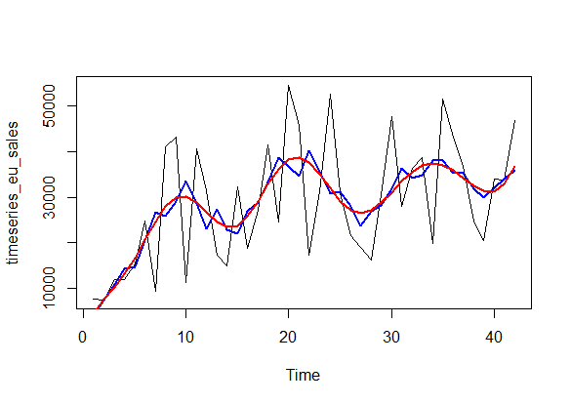
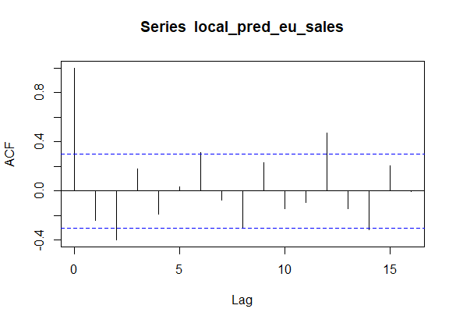
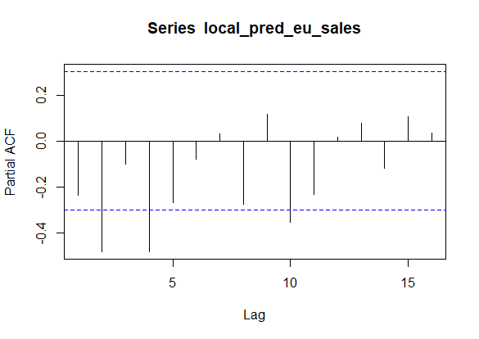
Time Series Analysis of Sales for CONSUMER Segment in EU marketplace with Trendline Degree 2 – MAPE 28.27

Slide 9
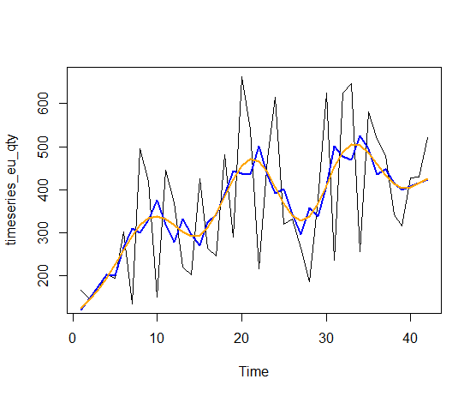
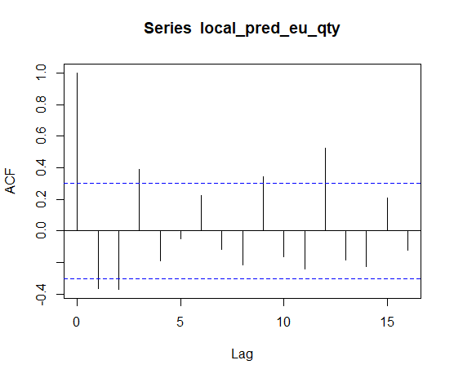
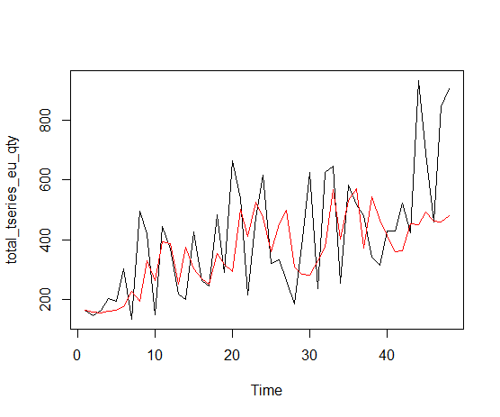
Time Series Analysis of Quantity for CONSUMER Segment in EU marketplace with Trendline Degree 2 – 30.49665
-- Actual Time Series
-- Predicted
-- Actual Time Series
-- Smoothen Time Series
-- Trend

Slide 10
Conclusions
The company should focus on the APAC and Consumer segment as per the prediction of the time series model.
As the demand is high in this region, highest number of resources should be deployed in this region. Deployment of resources can be proportional for the other regions too.

